Slide 1
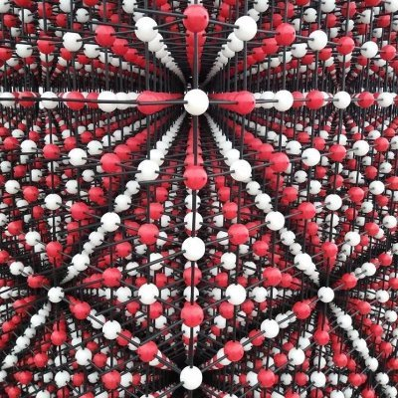
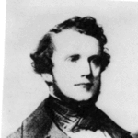
BPM: 2 Engineering Physics-II
UNIT –I: Crystal Structures and X-ray Diffraction
Lecture-1
By- Prof. B. K. Pandey, Dept. of Physics and Material Science
Auguste-Bravais

Slide 2


Slide 3
CHAPTER 1.CRYSTAL STRUCTURE
Elementary Crystallography
Solid materials (crystalline, polycrystalline, amorphous)
Crystallography
Crystal Lattice
Crystal Structure
Types of Lattices
Unit Cell
Directions-Planes-Miller Indices in Cubic Unit Cell
Typical Crystal Structures
(3D– 14 Bravais Lattices and the Seven Crystal System)
Elements of Symmetry

Slide 4
Matter
Matter
LIQUIDS and LIQUID CRYSTALS
GASES
SOLIDS

Slide 5
Gases
Gases have atoms or molecules that do not bond to one another in a range of pressure, temperature and volume.
These molecules haven’t any particular order and move freely within a container.

Slide 6

Liquids and Liquid Crystals
Similar to gases, liquids haven’t any atomic/molecular order and they assume the shape of the containers.
Applying low levels of thermal energy can easily break the existing weak bonds.
Liquid crystals have mobile molecules, but a type of long range order can exist; the molecules have a permanent dipole. Applying an electric field rotates the dipole and establishes order within the collection of molecules.
+ -
+ -
+ -
+ -
+ -
+ -
+ -

Slide 7

Solids
Solids consist of atoms or molecules executing thermal motion about an equilibrium position fixed at a point in space.
Solids can take the form of crystalline, polycrstalline, or amorphous materials.
Solids (at a given temperature, pressure, and volume) have stronger bonds between molecules and atoms than liquids.
Solids require more energy to break the bonds.

Slide 8

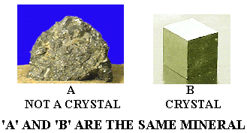
SOLID MATERIALS
CRYSTALLINE
Single Crystal
POLYCRYSTALLINE
AMORPHOUS
(Non-crystalline)

Slide 9
Types of Solids
Single crystal, polycrystalline, and amorphous, are the three general types of solids.
Each type is characterized by the size of ordered region within the material.
An ordered region is a spatial volume in which atoms or molecules have a regular geometric arrangement or periodicity.

Slide 10
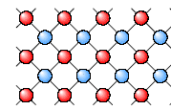
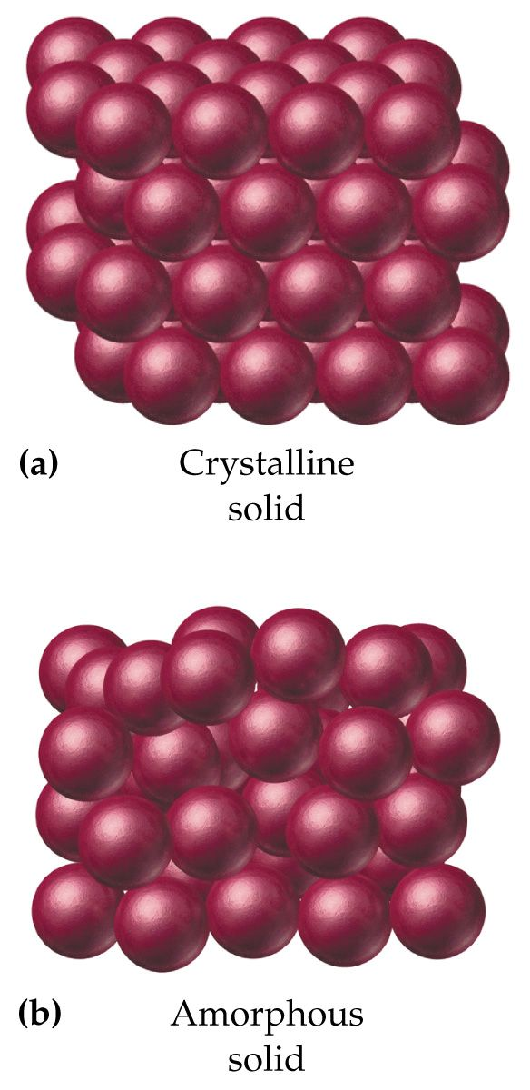
Crystalline Solid
Crystalline Solid is the solid form of a substance in which the atoms or molecules are arranged in a definite, repeating pattern in three dimension.
Single crystals, ideally have a high degree of order, or regular geometric periodicity, throughout the entire volume of the material.

Slide 11
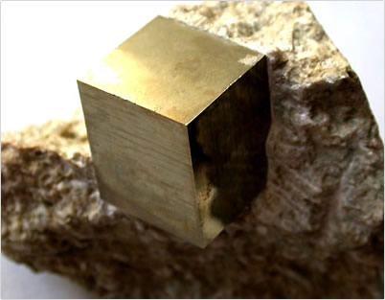
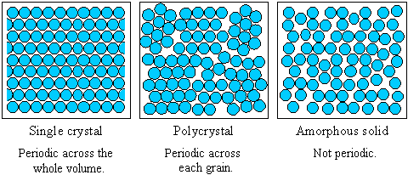
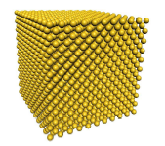
Crystalline Solid
Single crystal has an atomic structure that repeats periodically across its whole volume. Even at infinite length scales, each atom is related to every other equivalent atom in the structure by translational symmetry
Single Pyrite
Crystal
Amorphous
Solid
Single Crystal

Slide 12
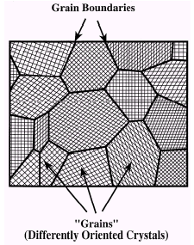
Polycrystalline Solid
Polycrystal is a material made up of an aggregate of many small single crystals (also called crystallites or grains).
Polycrystalline material have a high degree of order over many atomic or molecular dimensions.
Polycrystalline
Pyrite form
(Grain)

Slide 13
These ordered regions, or single crytal regions, vary in size and orientation wrt one another.
These regions are called as grains (domain) and are separated from one another by grain boundaries. The atomic order can vary from one domain to the next.
The grains are usually 100 nm - 100 microns in diameter.
Polycrystals with grains that are <10 nm in diameter are called nanocrystalline

Slide 14
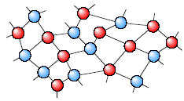
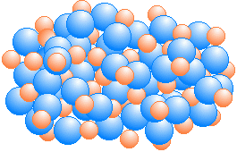
Amorphous Solid
Amorphous (Non-crystalline) Solid is composed of randomly orientated atoms , ions, or molecules that do not form defined patterns or lattice structures.
Amorphous materials have order only within a few atomic or molecular dimensions.
Amorphous solid have no sharp melting point.
Amorphous materials do not have any long-range order, but they have varying degrees of short-range order.
Examples to amorphous materials include amorphous silicon, plastics, and glasses.
Amorphous silicon can be used in solar cells and thin film transistors.

Slide 15
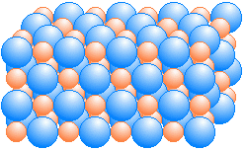
Departure From Perfect Crystal
Strictly speaking, one cannot prepare a perfect crystal. For example, even the surface of a crystal is a kind of imperfection because the periodicity is interrupted there.
Another example concerns the thermal vibrations of the atoms around their equilibrium positions for any temperature T>0°K.
As a third example, actual crystal always contains some foreign atoms, i.e., impurities. These impurities spoils the perfect crystal structure.

